Slide 1
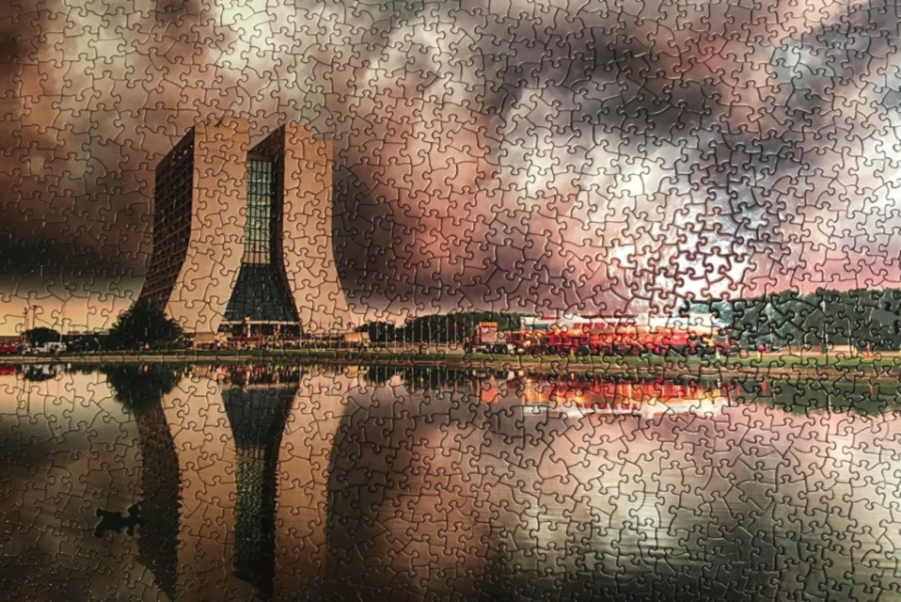
The current status of the Fermilab Muon g-2 Experiment
Nandita Raha, INFN Pisa (on behalf the Muon g-2 Collaboration)
7th International Conference on New Frontiers in Physics (ICNFP 2018)

Slide 2
Outline
Theoretical Background and Basic Technique
Experimental Performance and Comparison with the current best measurement (E821 at BNL)
Measurements and systematics
Conclusion
Notes:
2

Slide 3
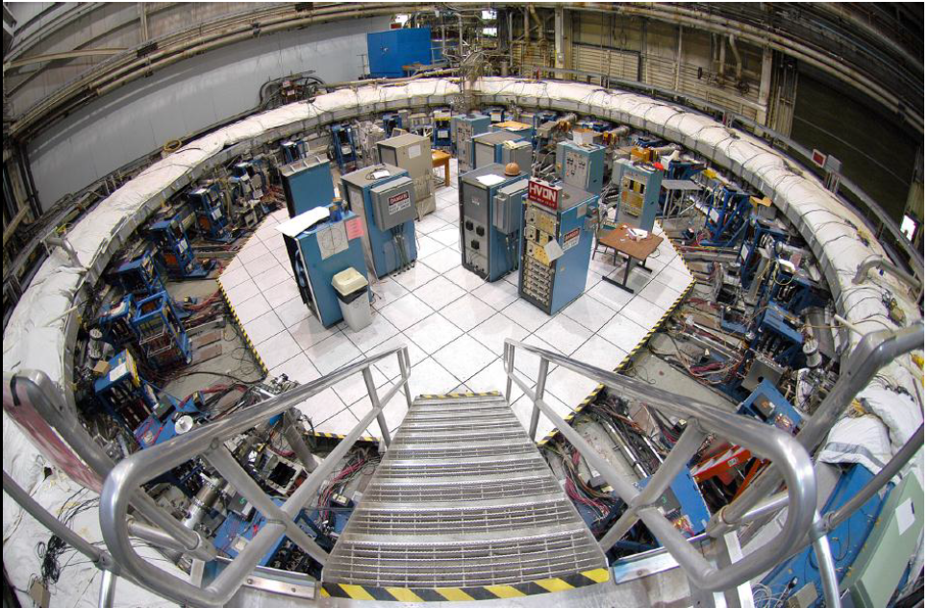
THEORETICAL BACKGROUND AND BASIC TECHNIQUE

Slide 4
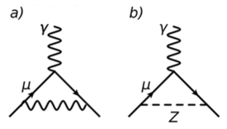
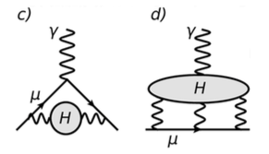
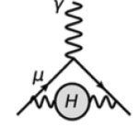
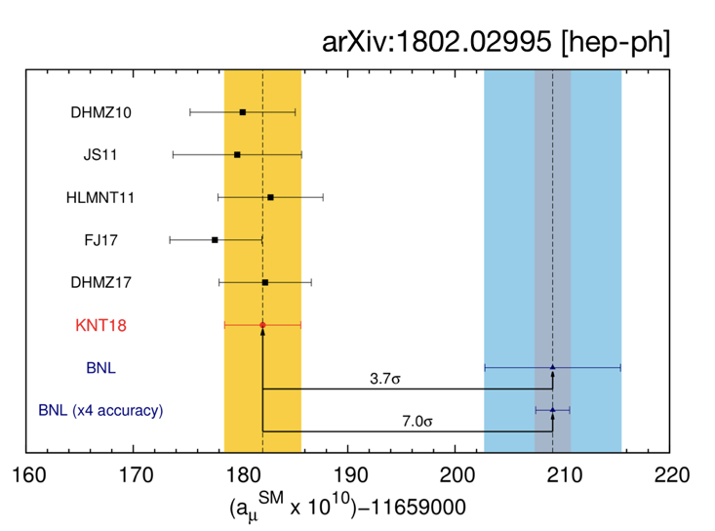
Muon g-2: The Basics
with g = 2 for a tree level anomaly (Dirac)
g = 2(Dirac) + Ο(10⁻³)_{QED} + Ο(10⁻⁹)_{EW} + Ο(10⁻⁷)_{QCD} + NP (?)
g_{SM} + g_{NP?} =
+
+
+
+
NP
4
Notes:
4

Slide 5
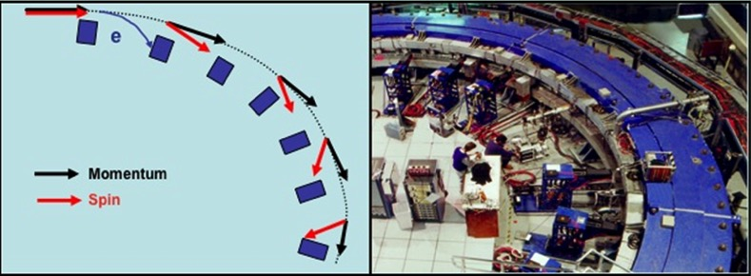
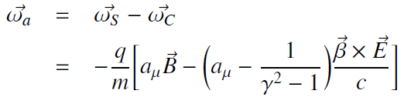
Muon g-2: The Basics
with g = 2 for a tree level anomaly (Dirac)
g = 2(Dirac) + Ο(10⁻³)_{QED} + Ο(10⁻⁹)_{EW} + Ο(10⁻⁷)_{QCD}
B
Magic p is at γ = 29.3
5
Notes:
5

Slide 6
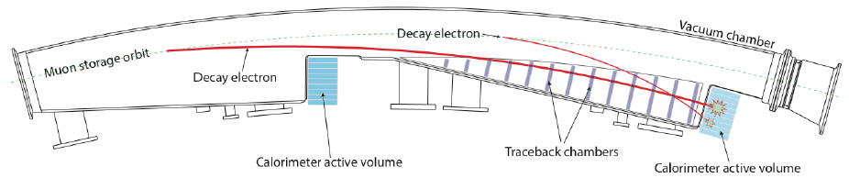
Muon g-2: The Basics
with g = 2 for a tree level anomaly (Dirac)
g = 2(Dirac) + Ο(10⁻³)_{QED} + Ο(10⁻⁹)_{EW} + Ο(10⁻⁷)_{QCD}
Tracking stations add much control over beam parameters
++ Electric dipole moment ++
B
Magic p is at γ = 29.3
6
Notes:
6

Slide 7
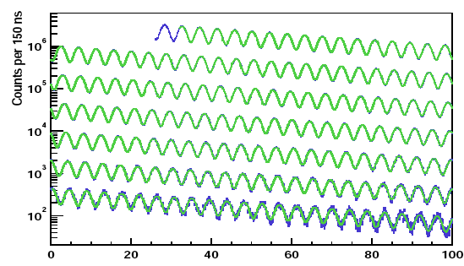
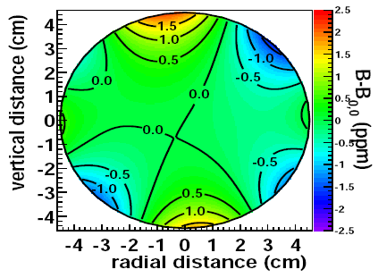
Muon anomalous moment measurement
Measure B → via NMR → recast a_{μ} in terms of proton precession frequency, ω_{p} (at B in its rest frame).
Muonic hyperfine experiment gives μ_{μ}/μ_{p} at ~26 ppb precision (ref. arXiv:1203.5425)
E821 data: e⁺ with E > 1.8 GeV
ω_{a}
ω_{p}
Positron spectrum gives distortions from
Pileup, gain stability
Beam Effects, Losses
7

Slide 8
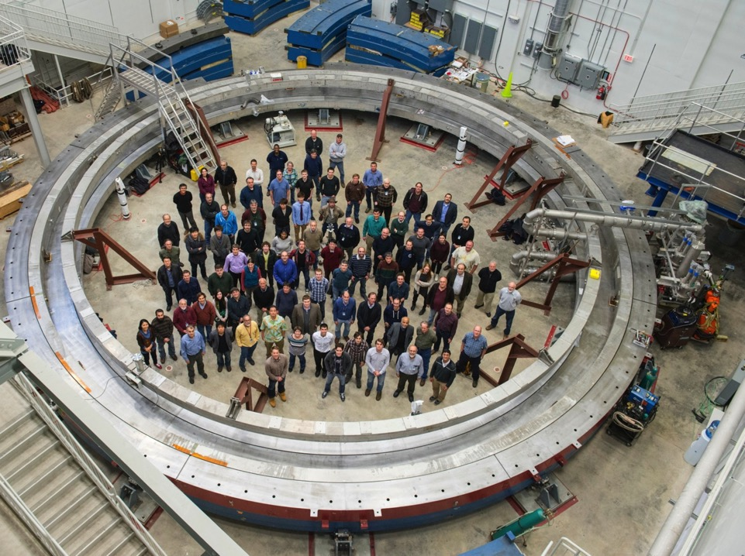
THE EXPERIMENT –
MUON BEAM PREPARATION, FOCUSING

Slide 9
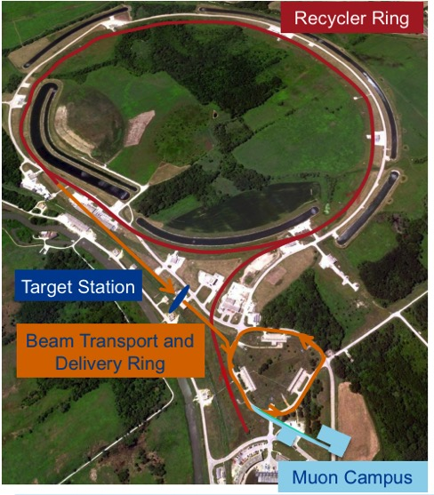
Muon Beam Preparation for 21x BNL statistics
Statistical error improvement is: 540 ppb → 140 ppb (~21 x BNL). This requires:
Better p, π and μ separation with improved collection
Delivery ring – eliminates background
Run Time: 18-24 months.
1 month engineering run 2017
Production run 1 ended today (April to July 7th )
Motivation
Target - 8 GeV protons produce 3.09 GeV π
Beam transport & Delivery ring – Long decay channels
9

Slide 10
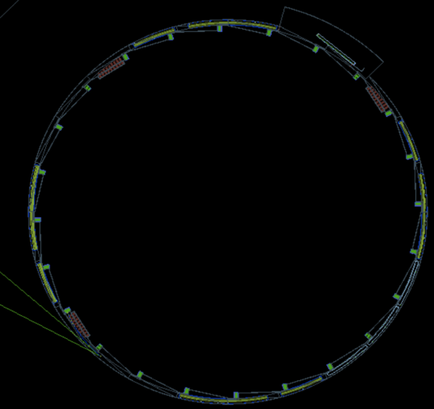
Muon Beam – Focusing in Storage Ring
Inflector
24
1
Q4
2
22
Calorimeters
Straw Trackers
Q1
Quadrupoles
Q3
K1
Kickers
16
K2
K3
Fiber Harp
Q2
10

Slide 11
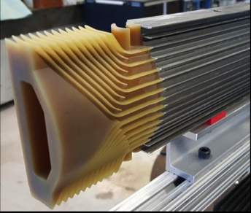
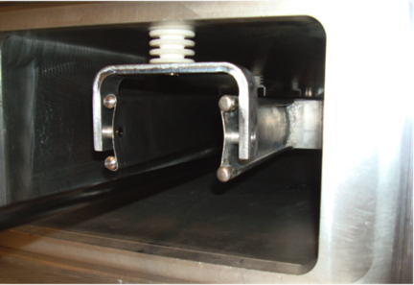
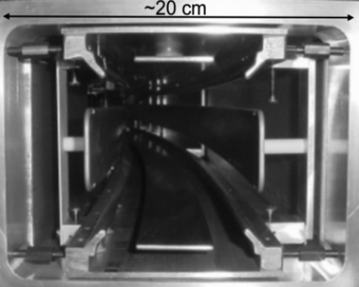
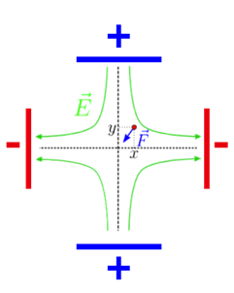
Muon Beam – Focusing in Storage Ring
Inflector – Superconducting coil to cancel 1.45 T field of ring
Kicker - pulsed magnet (~250 G peak) with vertical field, kicks the muons to the ideal orbit. Deflects by ~0.8 mrad
Quadrupoles – Electrostatic quads for focusing of beam. Four Aluminium electrodes.
Inflector
Kicker
Quadrupole
11

Slide 12
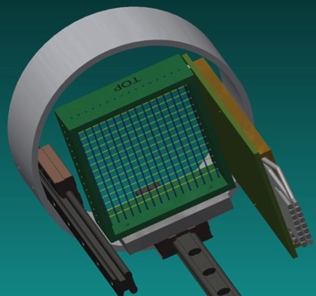
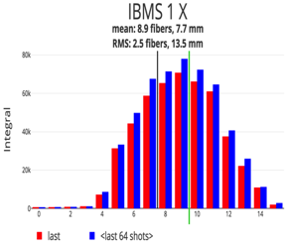
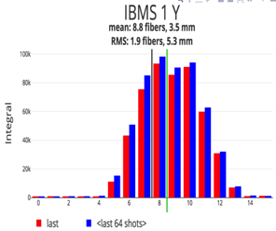
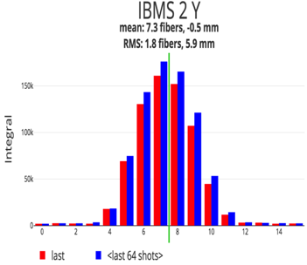
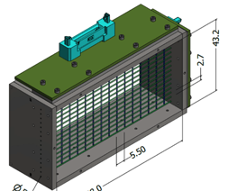
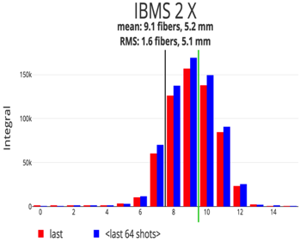
Inflector Beam Monitoring System
Scintillating-fibre (16 wires) beam profile monitors – Sample run
56.00 mm
IBMS
88.00 mm
12

Slide 13
Further improvements and checks – Current run
Inflector
24
1
2
22
Straw Trackers
16
Kickers
Fiber Harp
13

Slide 14
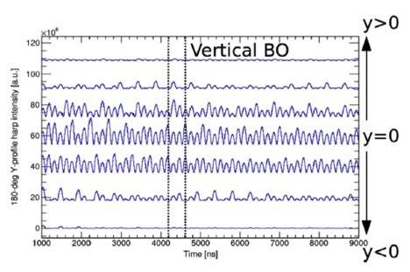
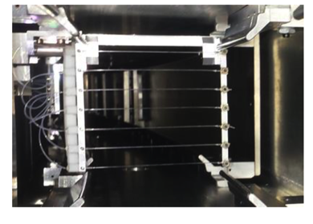
Fiber Harps – Checking the beam in Current run
Used to study behaviour of the muon beam flux and the horizontal and vertical oscillatory effects of the beam due to electric field. Taken occasionally in between data taking (not during the runs as it is an obstacle to the beam).
14

Slide 15
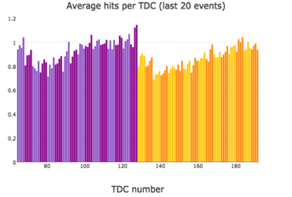
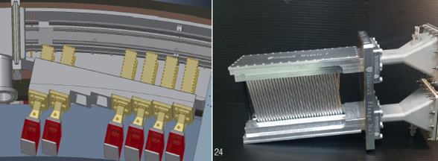
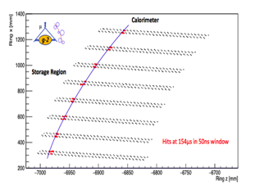
In–Vacuum Straw Trackers
2 Straw trackers installed in current run to reconstruct muon beam profile from e⁺ tracks (8 modules each with 128 straws containing Ar:CO₂)
15
Notes:
Remove Gain and Efficiency Tag

Slide 16
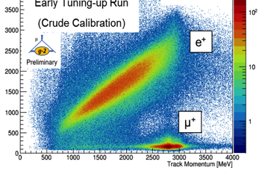
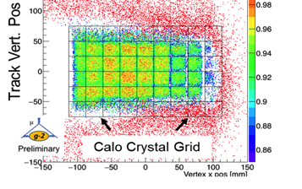
In–Vacuum Straw Trackers
2 Straw trackers installed in current run to reconstruct muon beam profile from e⁺ tracks (8 modules each with 128 straws containing Ar:CO₂)
Trackers in combination with calos, show good particle discrimination (left) and imaging of calos (right)
Preliminary Calibration
Calo Energy [MeV]
Track Momentum [MeV]
16
Notes:
Remove Gain and Efficiency Tag

Slide 17
THE EXPERIMENT –
SYSTEMATIC IMPROVEMENTS

Slide 18
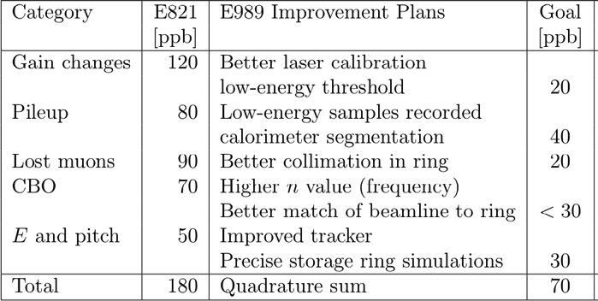
Systematic Improvements on ω_{a}
Systematics on ω_{a} 180 →70 ppb compared to E821. Achieved by:
Improved Calorimeters
Much improved Laser control system
New Straw Tracker (two installed in the current run)
Key element:
Laser
Calo + Laser
Calo + Laser
Inflector + Kicker
Tracker

Slide 19
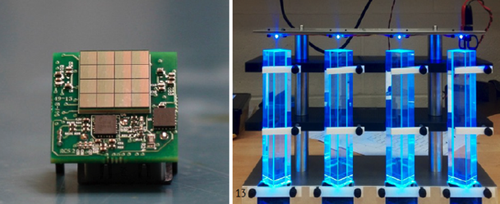
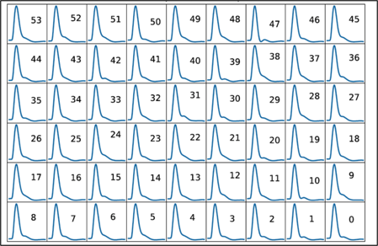
Calorimeters
Employ 24 calorimeters to produce positron spectrum
Each calorimeter is made up of 54(9x6) PbF₂ crystals with SiPMs (better in enduring the magnetic field) and read out by custom 800 MSPS waveform digitizers.
Custom pulse shapes (templates) used for each crystal
19

Slide 20
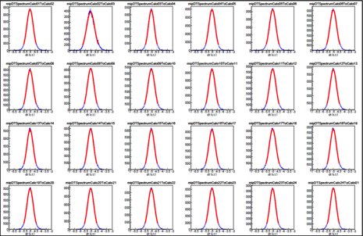
Calorimeters
Employ 24 calorimeters to produce positron spectrum
Each calorimeter is made up of 54(9x6) PbF₂ crystals with SiPMs (better in enduring the magnetic field) and read out by custom 800 MSPS waveform digitizers.
Custom pulse shapes (templates) used for each crystal
PbF₂ crystals provide excellent time resolution ~ 5 ps. Segmented (9x6) helps in better pileup protection.
20

Slide 21
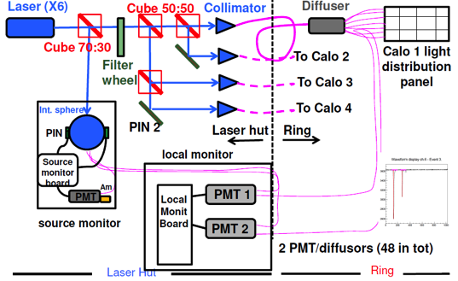
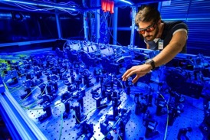
Monitoring / Calibration of Calorimeter - Laser
Laser calibration system – Laser light on calorimeters to calibrate them (use 6 laser heads).
6 SM (source monitor - 2 pin diodes + 1 PMT) to check and correct for laser light fluctuations.
24 LM (local monitors) that are used to check stability of the light distribution chain.
For calibration - Optical fibers carry laser shots to each of the 1296 calorimeter crystals. One laser head sends light to 4 calos as shown on the top fig.
21
Notes:
Make more slides – three points – explaining – Laser light on calo for calibrating them. SM to check fluctuations of Laser light and LM to check stability of the optical system

Slide 22
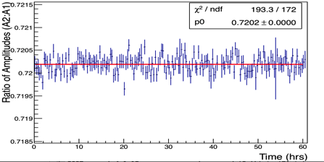
Laser Monitoring System - Stability
Timing and gain calibrations at the subpermil level requires the system to be very stable:
Stability of SM after temperature correction ~10⁻⁴
30 days dataset
30 days dataset
Time (days)
Time (days)
Stability of laser light distribution chain after temperature correction ~10⁻⁴ (measured by LM)
60 hour dataset
22
Notes:
Break in two slides – one for stability and one for gain calib. Gain calib has an initial drop due to flashes, higher muon flux etc. but stabilizes after 140 us (simulation)

Slide 23
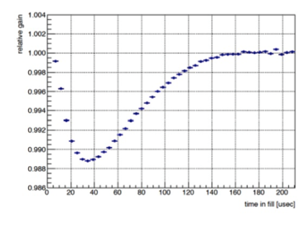
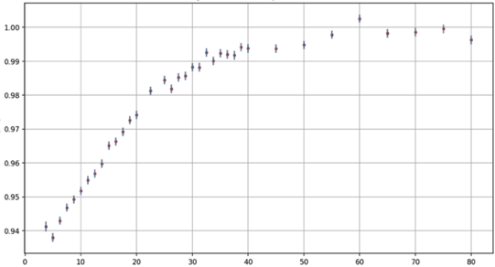
Monitoring / Calibration of Calorimeter - Laser
Muon data taken in 700 μs fills.
Gain of each SiPM crystal varies as shown on the right plot - calibrated using the laser system (simulation)
An initial drop observed due to higher muon flux (flash in the beam) which stabilizes after 140 μs
SiPM gain function
Experiment (with Laser)
Sample gain function from experimental data.
relative gain
PRELIMINARY
Time (nsec)
23
Notes:
Break in two slides – one for stability and one for gain calib. Gain calib has an initial drop due to flashes, higher muon flux etc. but stabilizes after 140 us (simulation)

Slide 24
Systematics in ω_{p}– Improvements
Systematics on ω_{p} 170 →70 ppb compared to E821. Achieved by:
Error Source | Improvement Plan for E989
Absolute Field calibration | 1.45 T calibration magnet with thermal enclosure (0.1ºC); additional probes; better electronics
Trolley probe calibrations | Plunging probes that can cross calibrate off-central probes; better position accuracy by physical stops;
Trolley measurements of B₀ | Reduced position uncertainty by factor of 2; improved rail irregularities; stabilized magnet field during measurements
Muon distribution | Additional probes at larger radii; improved field uniformity; improved muon tracking
Time – dependent external fields | Direct measurement of external fields; simulations of impact; active feedback
Others | Improved trolley power supply; trolley probes extended to larger radii; reduced temperature effects on trolley; measure kicker field transients
Improved shimming has a great effect on most systematics. Ex next slide. Using iron lamination in current run has made the magnetic field more uniform (about + 21 ppb)
24

Slide 25
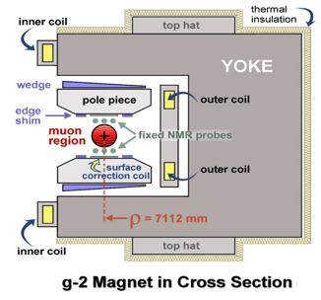
Magnetic Field Homogeneity / Upgrade – Current Run 1
Iron shims removes quadrupole asymmetries.
Top hats adjustments change the effective dipole moment.
Surface correction coils and iron foils – field more uniform.
378 Fixed probes at 72 locations around the ring
Trolley calibrations
25+ trolley run for better field mapping
Field stabilized to + 21 ppb
25
Notes:
25

Slide 26
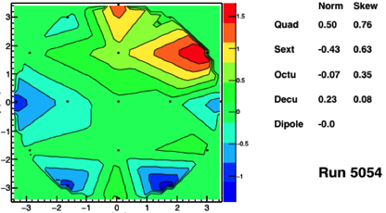
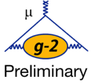
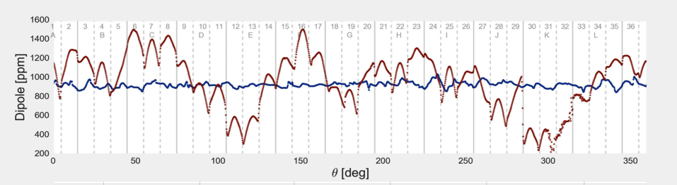
Magnetic Field Homogeneity / Upgrade – Current Run 1
Result of iron foils laminations, top hats, shimming etc. from the current run 1 data.
Goal 50 ppm
26
Notes:
26

Slide 27
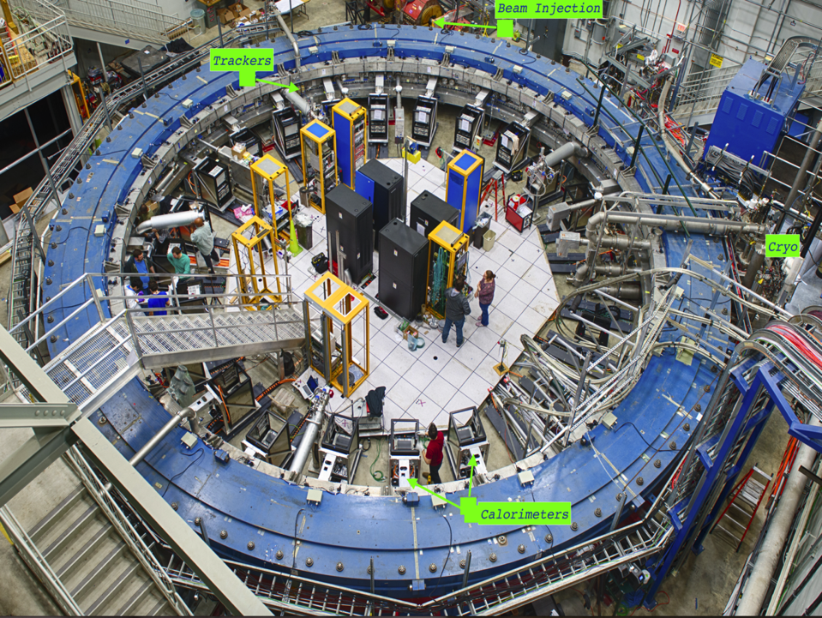
MEASUREMENTS AND SYSTEMATICS

Slide 28
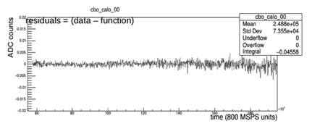
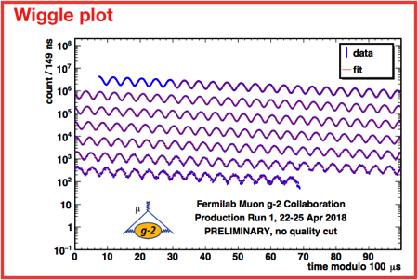
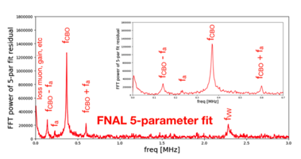
Current run brief analysis status
Several analysis using various method and at various places.
Blind the analysis with an offset (in clock frequencies and data)
Fitted the wiggle plot with T-method (distribution of decay e+ with time [T-mehtod] above a threshold frequency).
Residues due to CBO (or other effects)
Plot of residuals
28

Slide 29
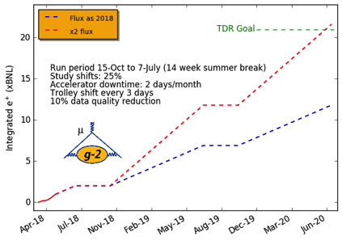
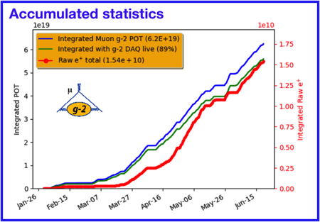
Summary and Outlook
Systematic and performance improvements compared to BNL E821.
Accumulated statistics 2.3 times BNL experiment and after quality cuts / reconstruction of data approx. = BNL.
Improve by 2020 to 140 ppb in the measurement of a_{μ.}
If the previous measure value of a_{μ} is correct, then we can have 7σ discrepancy from SM
TDR rate of positrons/fill
Run3
Run2
Run1
current rate of
positrons/fill
29

Slide 30

Thank You!
30

Slide 31
Backup

Slide 32

Feynman diagrams for two loop calculations

Slide 33

Feynman diagrams for three loop calculations

Slide 34


The Fundamental Experimental Principle
A more complete calculation which includes the effects of the focusing electrostatic field as well as a possible muon Electric Dipole Moment (EDM) :
Get a_{μ}
Magic γ∼29.3
EDM
Measure these
The magnetic field B is measured in terms of the Larmor frequency of a free proton
A possible EDM would result in a out of plane precession term

Slide 35

More about cyclotron – electric field for focusing – why?
B and β should be perpendicular for 2nd term to vanish.
Thus, use quads to vertically focus beam and keep muon p parallel to cyclotron momentum.
But the beam itself oscillates – CBO (coherent betatron oscillation) due to the slightly anomalies in focusing and cyclotron frequency itself. Horizontal component – is CBO and vertical is VM. These effects detected using fiber harps and reconstructing tracks away from the central orbit using straw trackers.
35

Slide 36
Systematics in ω_{a}– Accomplish these improvements
Error Source | Improvement Plan for E989
Gain Changes | Better laser calibration; low-energy threshold; temperature stability; eliminate hadronic flash
Pile up | Low-energy samples recorded; calorimeter segmentation; straw tracker to cross check
Lost Muons | Better collimation in ring; better tracking simulation/measurements using straw tracker
CBO | Higher n value (frequency); Better matching of beamline to ring
E and pitch | Improved tracker; Precise storage ring simulations, better kick
For the engineering run many of these have been accomplished with a scope of much more improvement in the next data runs.
For example – improved laser calibration system, using 3 straw trackers instead of 1..
36

Slide 37
Backup - Field measurements
378 Fixed probes at 72 locations around the ring in alternate sets of 2 (at 7112 mm & 7142 mm ) or 3 (at 7082, 7112 & 7142 mm)
Special B calib runs to measure B using moving 17 probes on a trolley
The above probes made of teflon and Al + Cu
Absolute calibration of all these probes (as their materials can slightly perturb B) done using H₂O in pyrex (called abs calib probe)
In specially well shimmed parts with high uniformity trolley probes need absolute calibration using plunging probes; help in cross calibrations too
37

Slide 38
Backup - Field measurements
B₀ is the field at the center of the storage ring
Value of wp is found by the weighted average of field weighted with muon distribution.
In BNL, proton beam was extracted and muons were stored during the at-top of the cycle, with no effect on the g-2 measurement. But in E989, time-dependent magnetic fields from sources such as the Booster accelerator, and power lines could perturb the field in the storage ring at the ppb level. Error budget 5 ppb.
38

